Slide 1

Mechatronic system design & labs
Quadcopter
POLITECNICO DI MILANO

Slide 2

Our project group
S.Jalaladdin Abbasi.K – ID: 10648899 – Matricola: 927516
Davide Fontana – ID: 10536049 – Matricola: 944879
Lorenzo Mantovani – ID: 10532945 – Matricola: 946281
Alessandro Sotti – ID: 10526312 – Matricola: 945186
Ifraz Ahamed Syed Sirajuddin – ID: 10702171 – Matricola: 940900
POLITECNICO DI MILANO

Slide 3
Index
Introduction
Model and Data Acquisition
Complementary Filter
PID
LQR
Kalman Filter
Noise and Disturbances
Simulink Model
POLITECNICO DI MILANO

Slide 4
Introduction
The quadcopter is a device which hovers in the air and has many practical applications. The challenges of this system is just as similar to any other non-linear system, suffers from stability due to disturbances.
Our aim is to mitigate the effects of the disturbances and make the system follow the optimal trajectory by maintaining the stability of the system.
This operation is performed by identifying the optimal control for our system by using different optimal control techniques.
POLITECNICO DI MILANO

Slide 5
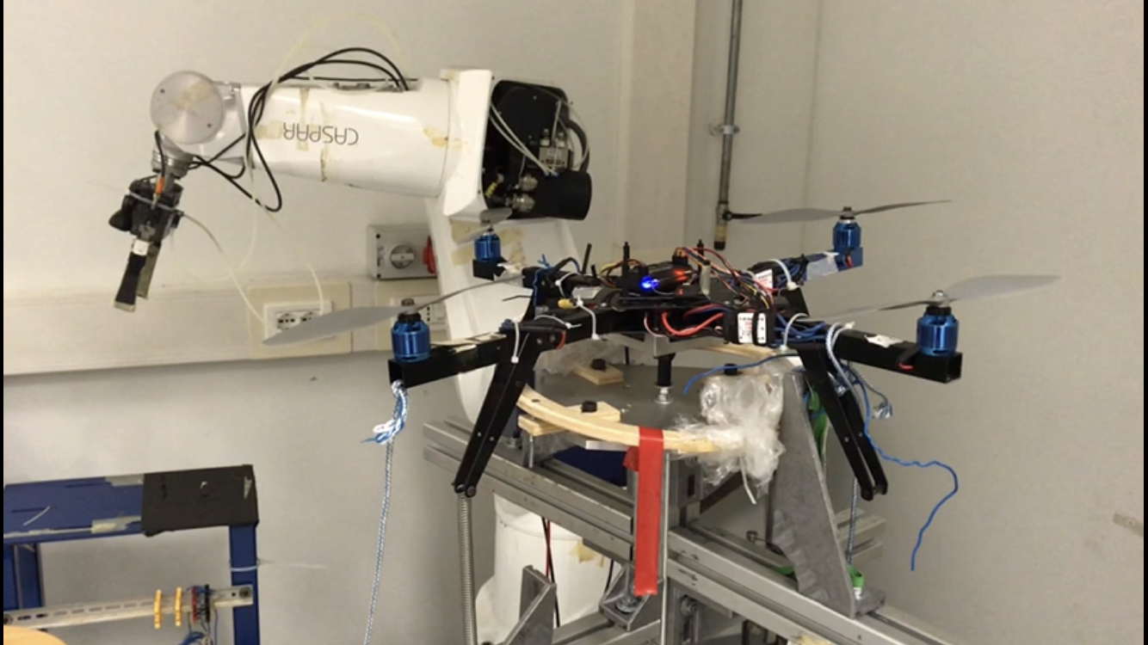
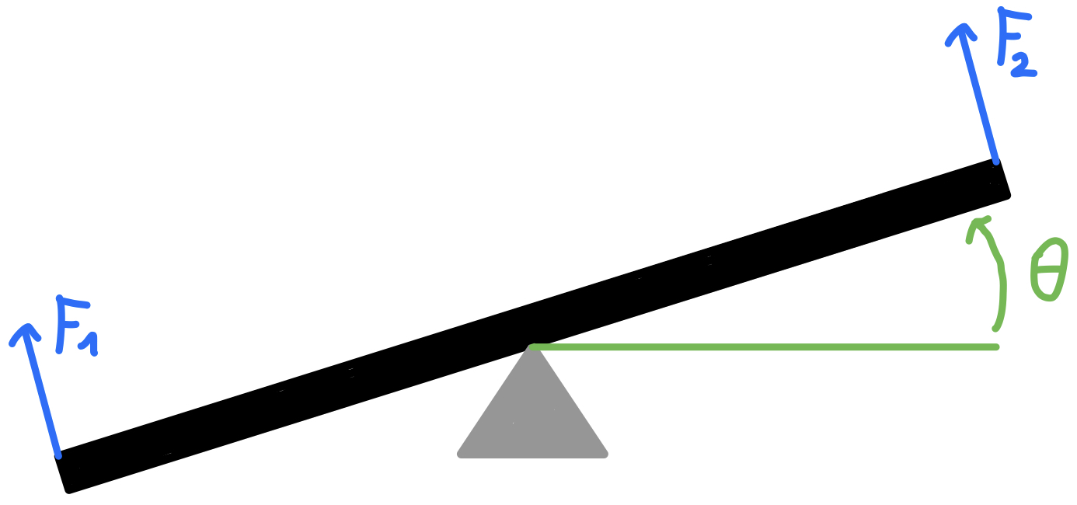
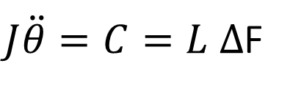
Model: 2 dof vs 1 dof
The real system:
4 motors
2 DOF
$J\ddot{θ}=C=L Δ$F
The modeled system:
2 motors
1 DOF (θ)
POLITECNICO DI MILANO

Slide 6
Model: datas from the quadcopter
The system gives back 14 different signals:
ch 1: time elapsed [ms]
ch 2: realtime [bool]
ch 3: IMU-GYRO p [deg/s]
ch 4: IMU-GYRO q [deg/s]
ch 5: IMU-GYRO r [deg/s]
ch 6: IMU-ACC x [g]
ch 7: IMU-ACC y [g]
ch 8: IMU-ACC z [g]
ch 9: IMU-TMP T [Â°C]
ch 10: PWM ch 1 [us]
ch 11: PWM ch 2 [us]
ch 12: PWM ch 3 [us]
ch 13: PWM ch 4 [us]
ch 14: safe mode [bool]
POLITECNICO DI MILANO

Slide 7
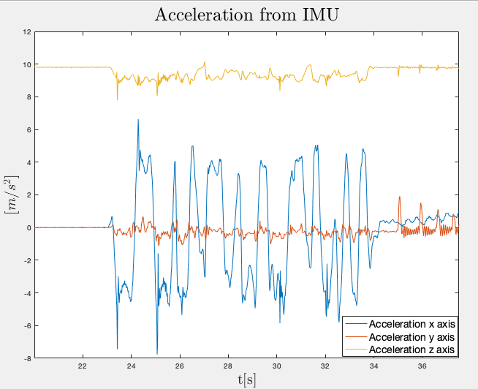
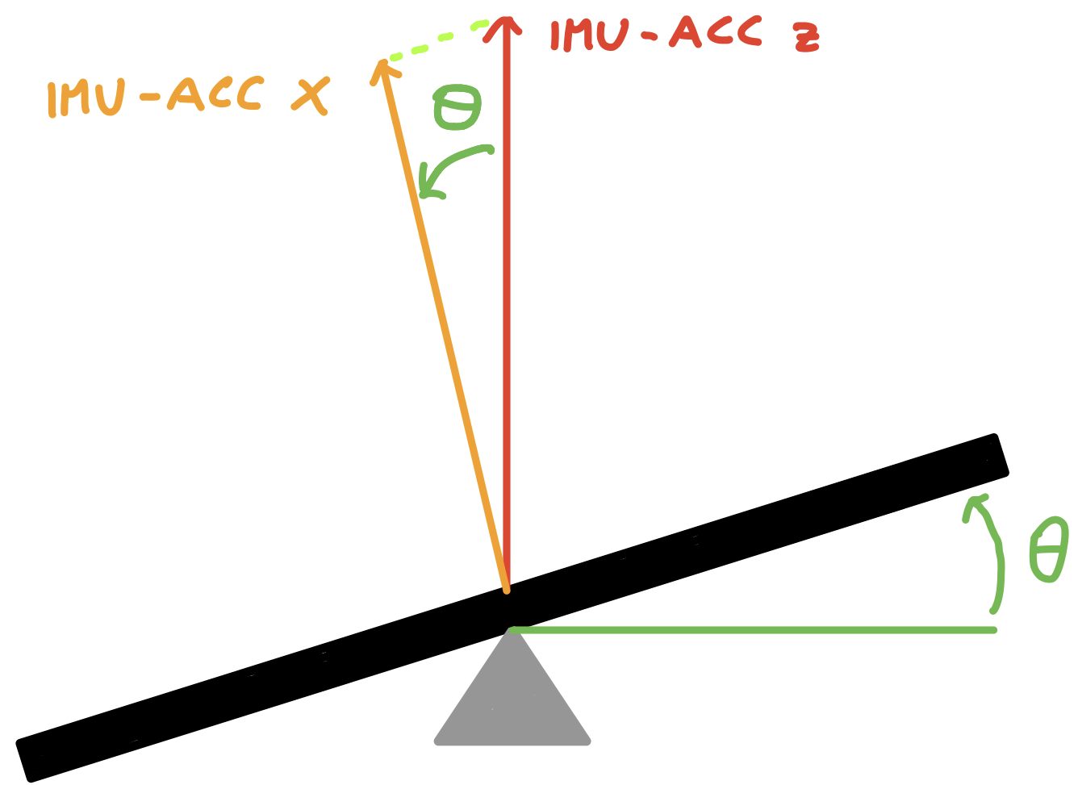

Model: evaluation of θ
Acceleration on x axis (ch 6): depends on θ
Acceleration on z axis (ch 8): always constant
$Θ=atan\frac{ch 6}{ch 8}$
POLITECNICO DI MILANO

Slide 8
Complementary filter: accelerometer vs gyroscope
Pros:
Good accuracy at low frequencies
Can sense both static and dynamic acceleration
Accelerometer:
Cons:
High sensitivity to vibrations
Pros:
Good for measuring angular rate of rotation
Gyroscope:
Cons:
Drifts of the signal due to integration over time
POLITECNICO DI MILANO

Slide 9
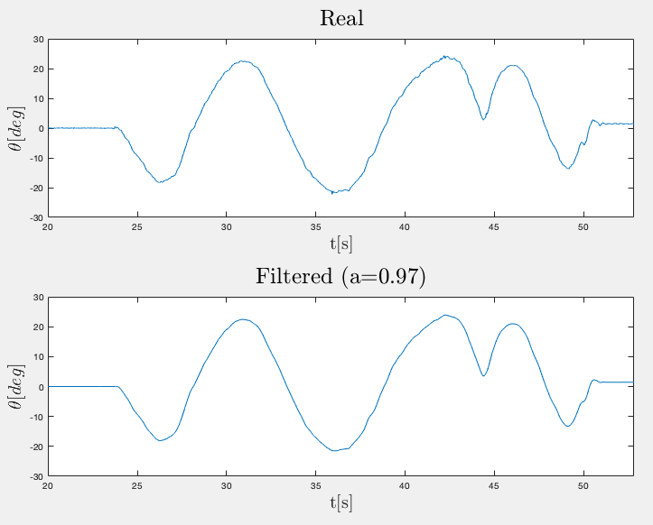
Complementary filter: how it works
Low pass filter: filters the the high frequency signals when the accelerometer sense condition of vibration
High pass filter: to negate the drift contribution
_{Equation:}
θ_{i}=a*(θ_{i-1}+gyro_{x,i}*dt_{i})+(1-a)*IMUacc_{x,i}
POLITECNICO DI MILANO

Slide 10
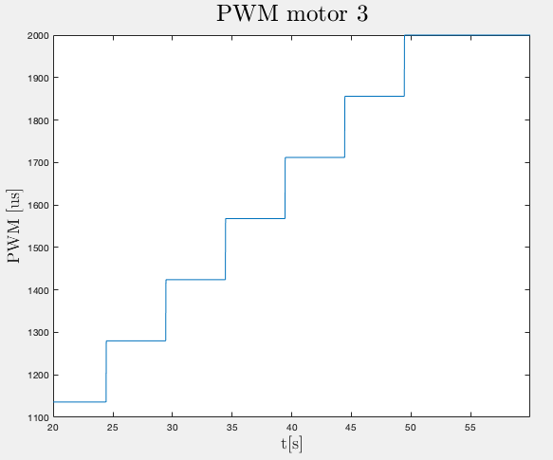
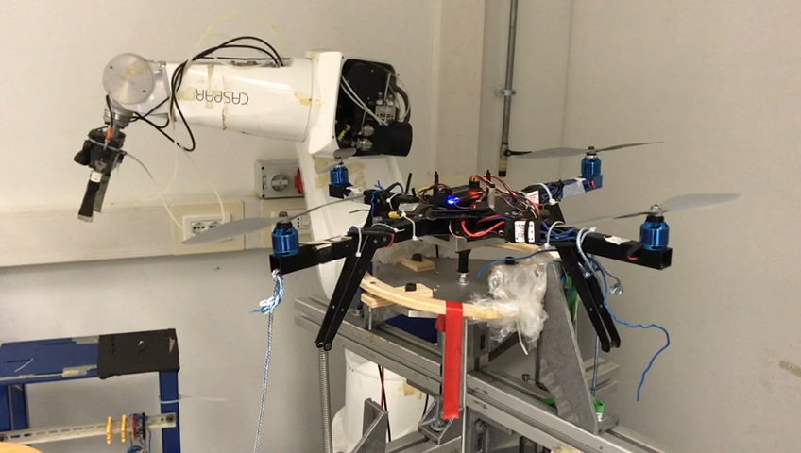
Thrust force: motors and springs
The basic idea is to measure the thrust force of the motors through the measurement of the extension (and compression) of springs that have been fixed on the base of the quadcopter.
POLITECNICO DI MILANO

Slide 11
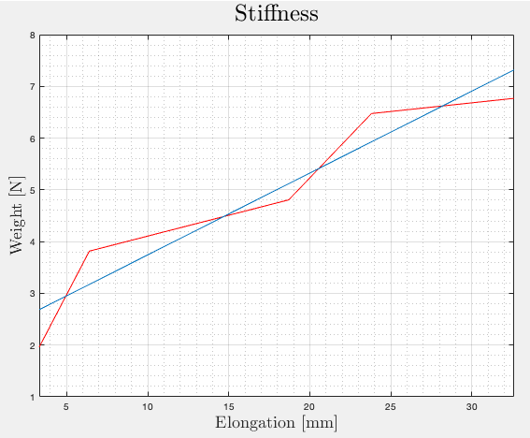
Thrust force: stiffness evaluation
K=158.3 [N/m]
POLITECNICO DI MILANO

Slide 12
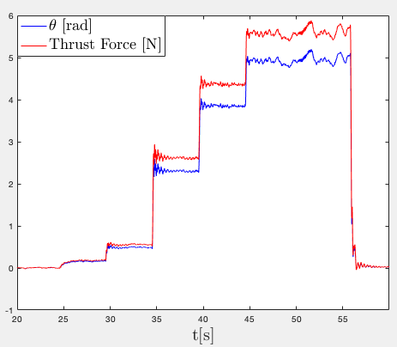
Thrust force: force at every angulation
POLITECNICO DI MILANO

Slide 13
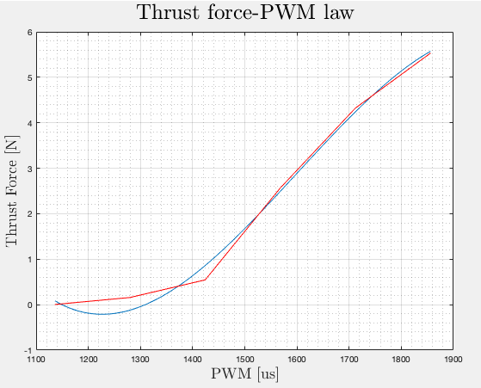
Thrust force: stiffness evaluation
Linear range ≈ 1÷5 N
POLITECNICO DI MILANO

Slide 14
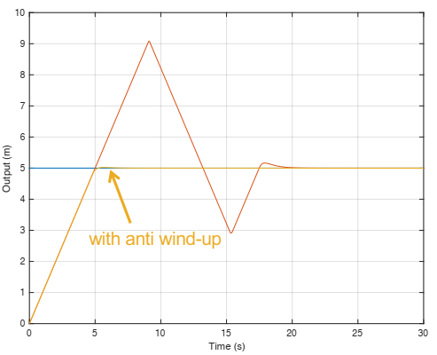
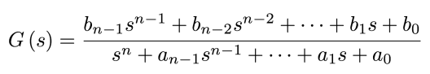
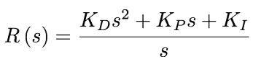
PID Continuous Time Domain
Proportional Integral Derivative control
Have a better estimation of the controlled system
Modifying the gains: obtaining required criteria
Anti-wind up Filter
POLITECNICO DI MILANO

Slide 15
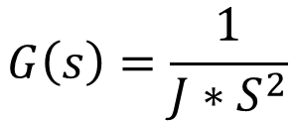
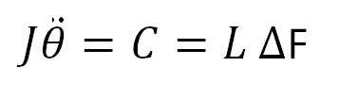
PID Continuous Time Domain
System in Laplace Domain
$J\ddot{θ}=C=L Δ$F
$$G\left(s\right)=\frac{1}{J∗S^{2}}$$
POLITECNICO DI MILANO

Slide 16
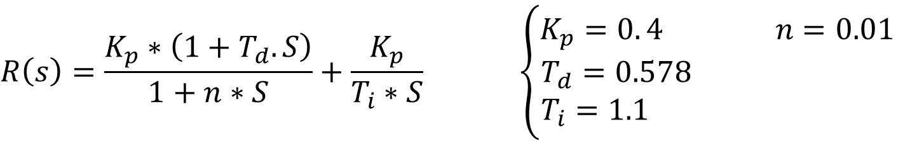
PID Continuous Time Domain
Control Synthesis: Bode Criteria not applicable
High phase margin
Slope -1 in the cross over frequency
Definition of a Transfer Function
Damped and quick transient
Minimal Steady-state error
$$R\left(s\right)=\frac{K_{p}∗\left(1+T_{d}.S\right)}{1+n∗S}+\frac{K_{p}}{T_{i}∗S} \left\{\begin{aligned}K_{p}=0. 4 n=0.01 \\ T_{d}=0.578 \\ T_{i}=1.1 \end{aligned}\right.$$
POLITECNICO DI MILANO

Slide 17
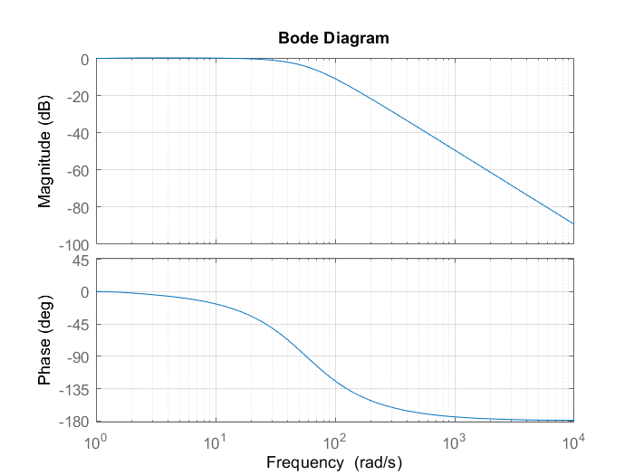
PID Continuous Time Domain
Bod Diagram of the closed loop system
POLITECNICO DI MILANO

Slide 18
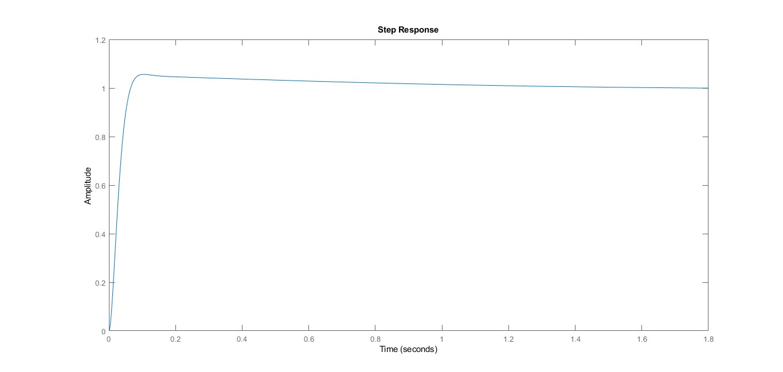
PID Continuous Time Domain
Step Response
Low overshoot
Damped transient
Zero Steady state error
Small rise and settling time
POLITECNICO DI MILANO

Slide 19
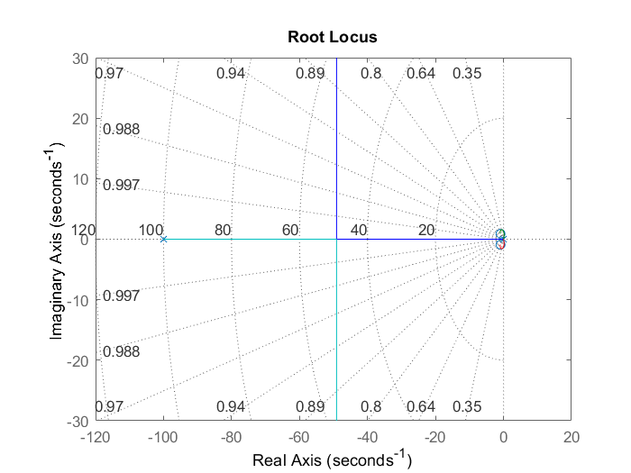
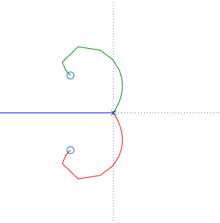
PID Continuous Time Domain
Root Locus: indication of Stability
4 poles (2 of system+2 of controller),
2 zeros (of controller) for the Closed loop systm
POLITECNICO DI MILANO

Slide 20
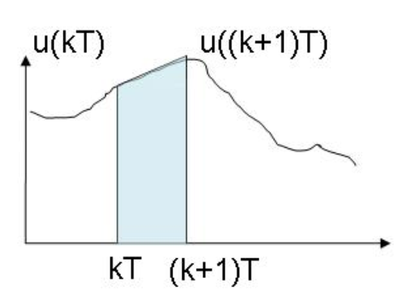
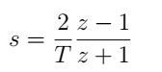
PID Discrete Time Domain
Sampling Frequency: 50 Hz
Continuous to Discrete domain: Laplace to Z-Transfrom
Tustin discretization:
Anti-Aliasing Filter
POLITECNICO DI MILANO

Slide 21
PID Discrete Time Domain
Position and Velocity variations with time
POLITECNICO DI MILANO

Slide 22
PID Discrete Time Domain
Torque variation with time
POLITECNICO DI MILANO

Slide 23
PID Discrete Time Domain
Force 1, and Force 2 variations with time
POLITECNICO DI MILANO

Slide 24
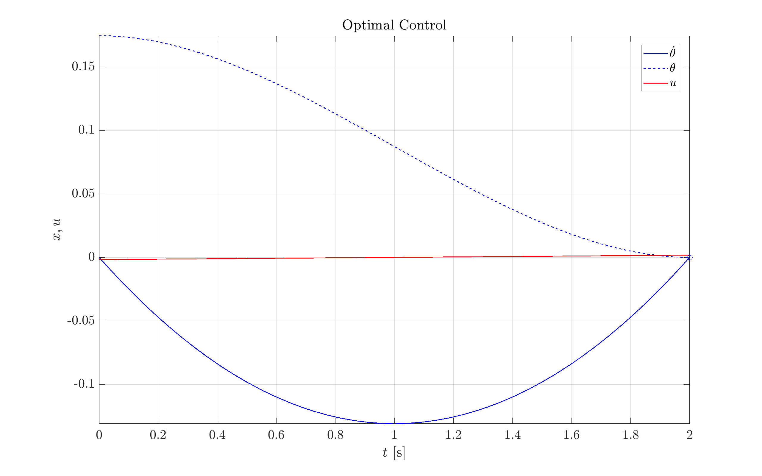
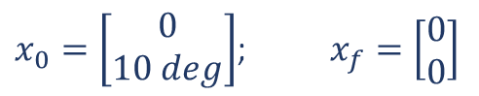
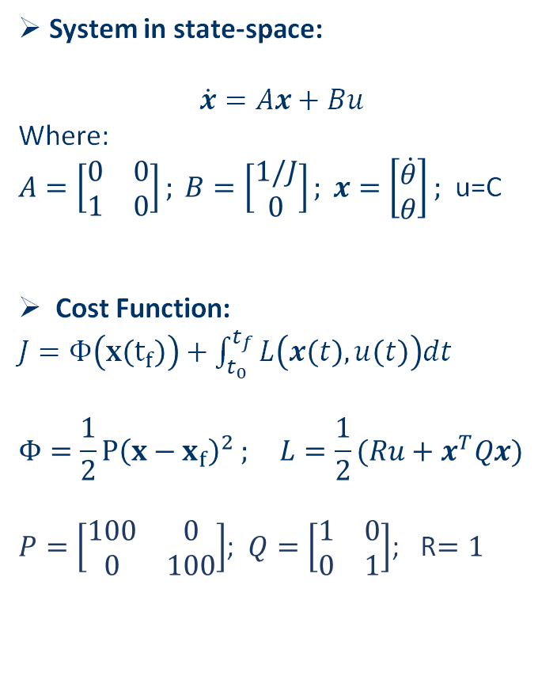
Optimal Control
System in state-space:
$$\dot{x}=Ax+Bu$$
Where:
$A=\left[\begin{matrix}0 & 0 \\ 1 & 0\end{matrix}\right]; B=\left[\begin{matrix}1/J \\ 0\end{matrix}\right]; x=\left[\begin{matrix}\dot{θ} \\ θ\end{matrix}\right];$ u=C
Cost Function:
$J=Φ\left(x\left(t_{f}\right)\right)+\int_{t_{0}}^{t_{f}}{L\left(x\left(t\right),u\left(t\right)\right)dt}$
$$Φ=\frac{1}{2}P{\left(x−x_{f}\right)}^{2} ; L=\frac{1}{2}(Ru+x^{T}Qx)$$
$P=\left[\begin{matrix}100 & 0 \\ 0 & 100\end{matrix}\right]$; $Q=\left[\begin{matrix}1 & 0 \\ 0 & 1\end{matrix}\right]$; R$=1$
$x_{0}=\left[\begin{matrix}0 \\ 10 deg\end{matrix}\right]$; $x_{f}=\left[\begin{matrix}0 \\ 0\end{matrix}\right]$
POLITECNICO DI MILANO

Slide 25
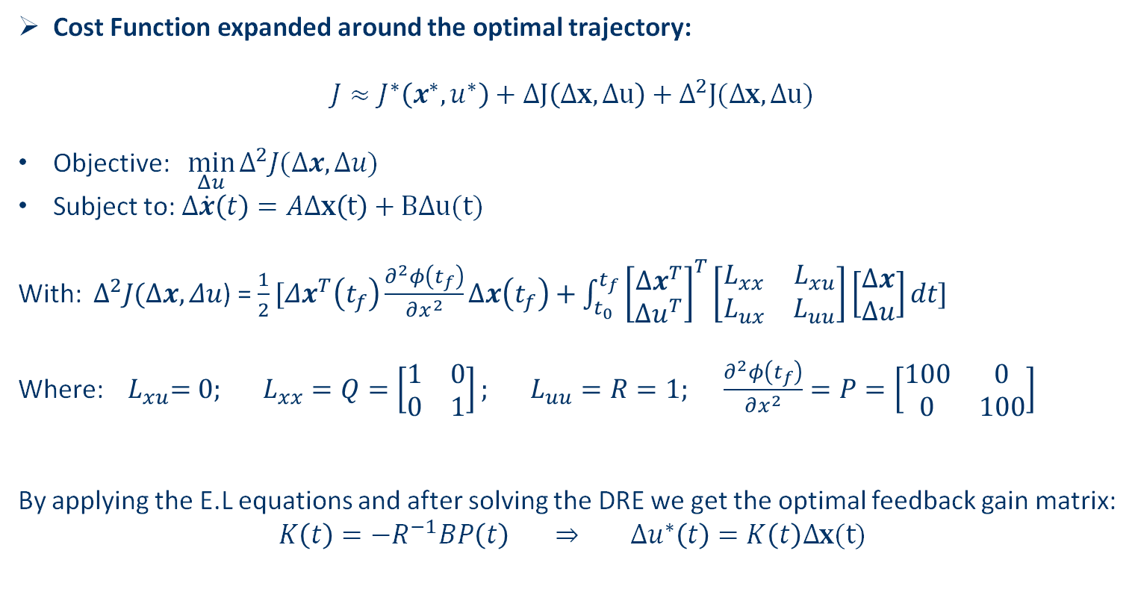
LQR
Cost Function expanded around the optimal trajectory:
$$J≈J^{∗}\left(x^{∗},u^{∗}\right)+ΔJ\left(Δx,Δu\right)+Δ^{2}J(Δx,Δu)$$
Objective: $\min_{Δu}{Δ^{2}J(Δx,Δu)}$
Subject to: $Δ\dot{x}\left(t\right)=AΔx\left(t\right)+BΔu(t)$
With: ${ Δ}^{2}J(Δx,Δu$) = $\frac{1}{2}[Δx^{T}\left(t_{f}\right)\frac{∂^{2}φ\left(t_{f}\right)}{∂x^{2}}Δx\left(t_{f}\right)+\int_{t_{0}}^{t_{f}}{{\left[\begin{matrix}Δx^{T} \\ Δu^{T}\end{matrix}\right]}^{T}\left[\begin{matrix}L_{xx} & L_{xu} \\ L_{ux} & L_{uu}\end{matrix}\right]\left[\begin{matrix}Δx \\ Δu\end{matrix}\right]dt] }$
Where: ${ L}_{xu}=0; L_{xx}=Q=\left[\begin{matrix}1 & 0 \\ 0 & 1\end{matrix}\right]; L_{uu}=R=1; \frac{∂^{2}φ\left(t_{f}\right)}{∂x^{2}}=P=\left[\begin{matrix}100 & 0 \\ 0 & 100\end{matrix}\right]$
By applying the E.L equations and after solving the DRE we get the optimal feedback gain matrix:
$$K\left(t\right)=−R^{−1}BP\left(t\right) ⇒ Δu^{∗}\left(t\right)=K\left(t\right)Δx(t)$$
POLITECNICO DI MILANO

Slide 26
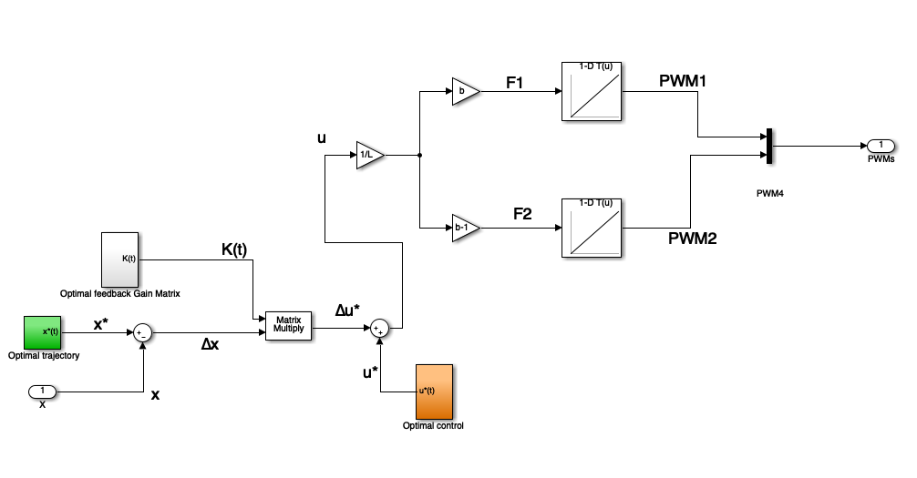
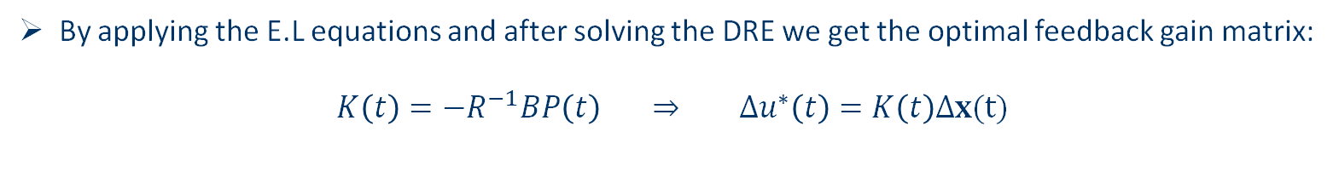
LQR
By applying the E.L equations and after solving the DRE we get the optimal feedback gain matrix:
$$K\left(t\right)=−R^{−1}BP\left(t\right) ⇒ Δu^{∗}\left(t\right)=K\left(t\right)Δx(t)$$
POLITECNICO DI MILANO

Slide 27
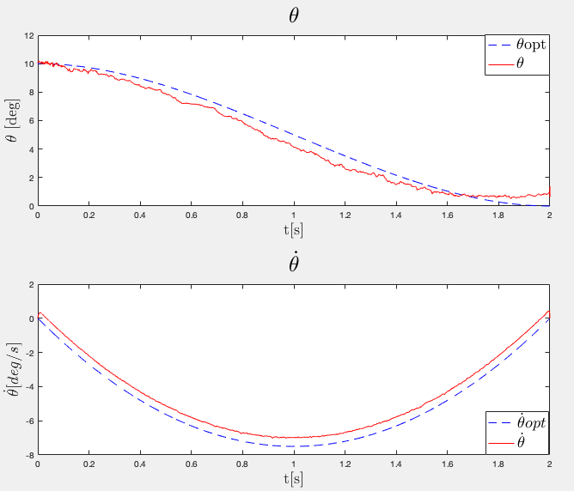
LQR
Results:
POLITECNICO DI MILANO

Slide 28
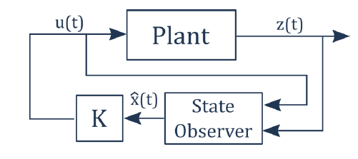
Kalman filter
System inputs:
X and Z axis accelerometer
Y axis gyroscope
Initial conditions:
Real: [10 , 10] (deg/s, deg)
Kalman: [0, 6] (deg/s, deg)
POLITECNICO DI MILANO

Slide 29
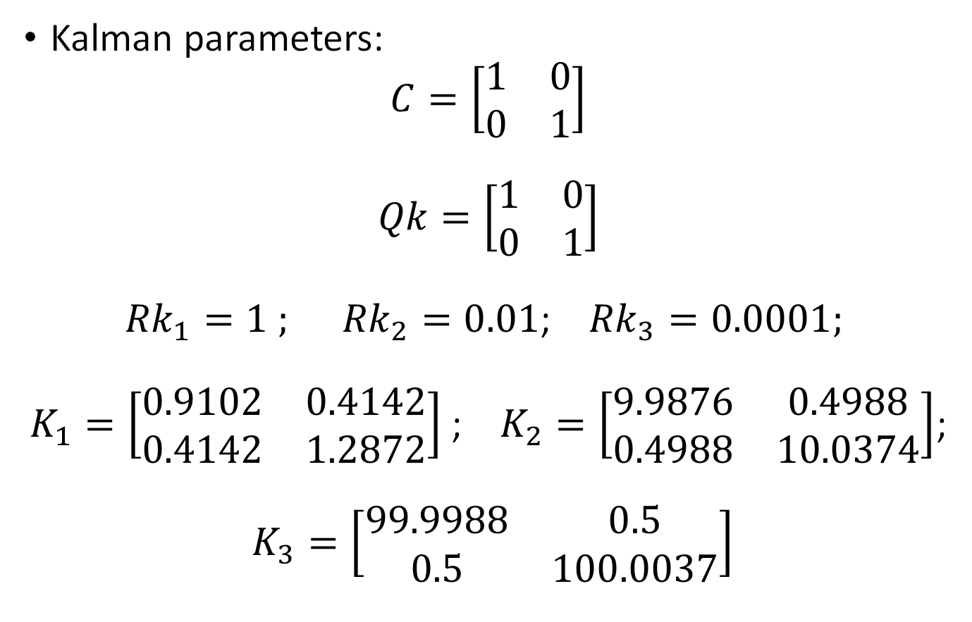
Kalman filter
Kalman parameters:
$$C=\left[\begin{matrix}1 & 0 \\ 0 & 1\end{matrix}\right]$$
$$Qk=\left[\begin{matrix}1 & 0 \\ 0 & 1\end{matrix}\right]$$
${Rk}_{1}=1 ;$ ${Rk}_{2}=0.01$; ${Rk}_{3}=0.0001;$
$K_{1}=\left[\begin{matrix}0.9102 & 0.4142 \\ 0.4142 & 1.2872\end{matrix}\right]$ ; $K_{2}=\left[\begin{matrix}9.9876 & 0.4988 \\ 0.4988 & 10.0374\end{matrix}\right]$;
$K_{3}=\left[\begin{matrix}99.9988 & 0.5 \\ 0.5 & 100.0037\end{matrix}\right]$
POLITECNICO DI MILANO

Slide 30
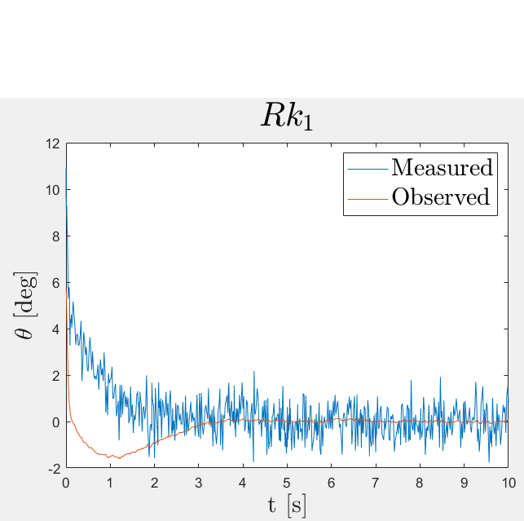
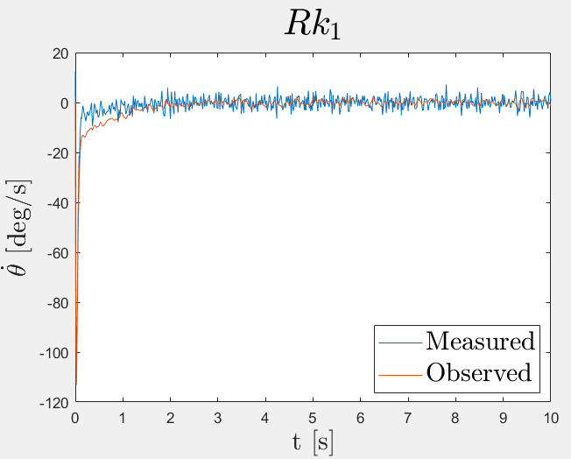
Kalman filter
POLITECNICO DI MILANO

Slide 31
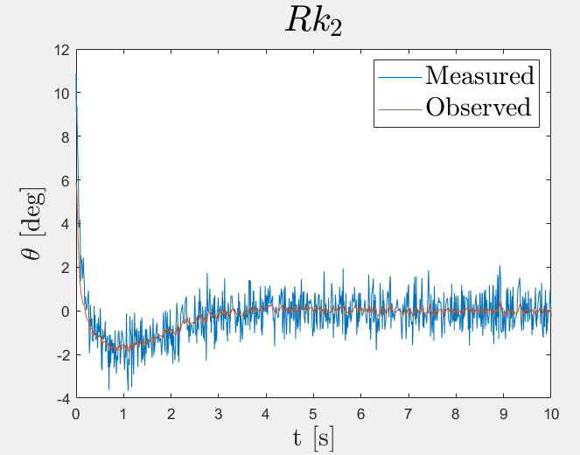
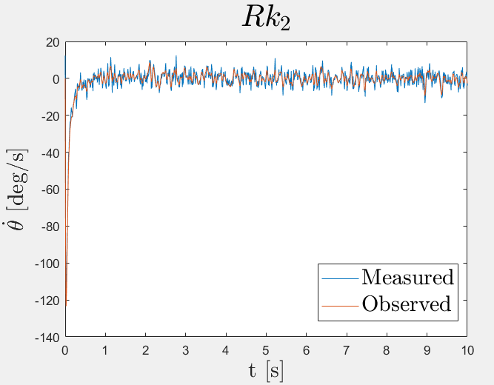
Kalman filter
POLITECNICO DI MILANO

Slide 32
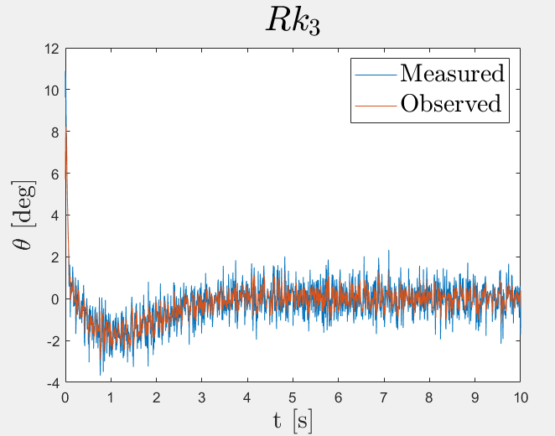
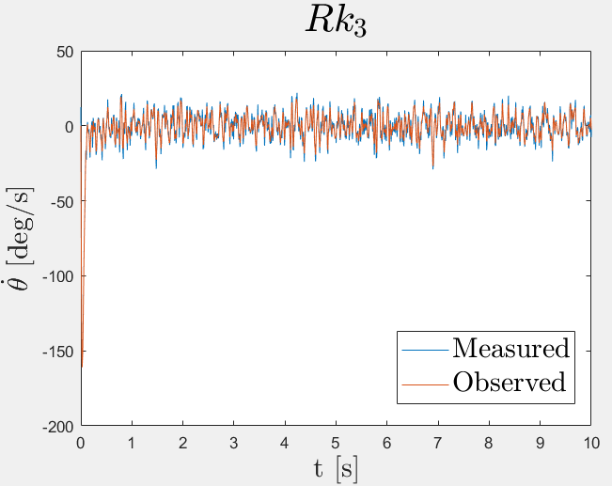
Kalman filter
POLITECNICO DI MILANO

Slide 33
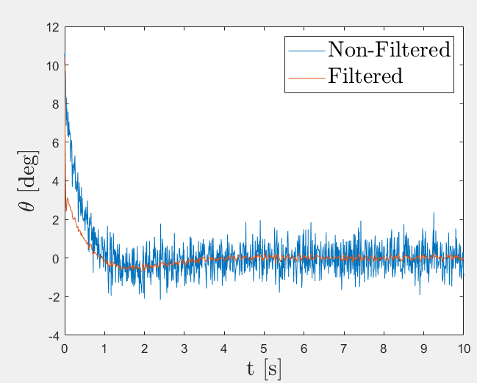
Kalman filter v.s. Complementary filter
Comparison between Kalman filter and complementary filter
POLITECNICO DI MILANO

Slide 34
Measurement noise and disturbances
To make the model more accurate noise and disturbances we added:
Measurement noise: gaussian white noise on the accelerometers (σ= 0,0127) and the gyroscope(σ= 0,0002) obtained by looking at the sensor reading on the still system.
Disturbances on motors: slightly different relationship between the PWMs and the force values compared to the one in the controllers.
POLITECNICO DI MILANO

Slide 35
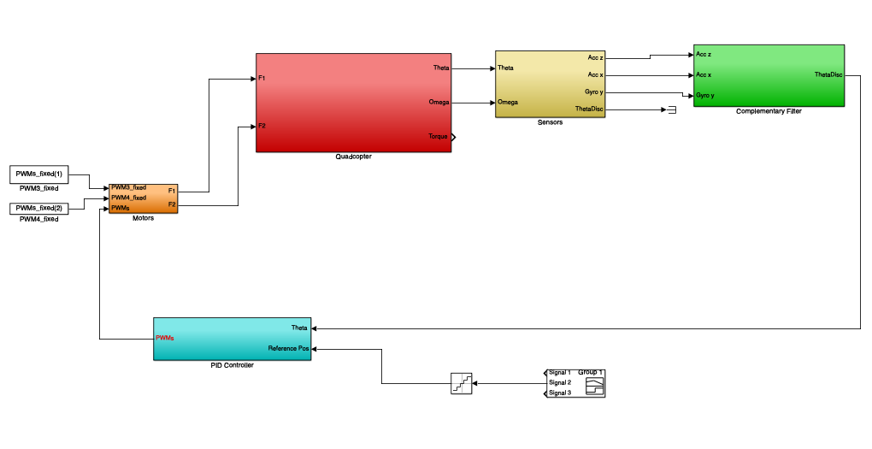
Simulink
POLITECNICO DI MILANO

Slide 36
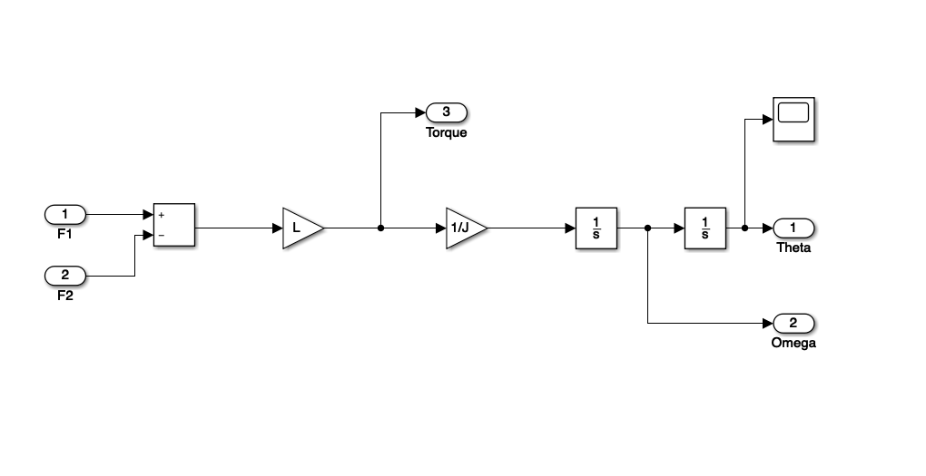
Simulink: Quadcopter
POLITECNICO DI MILANO

Slide 37
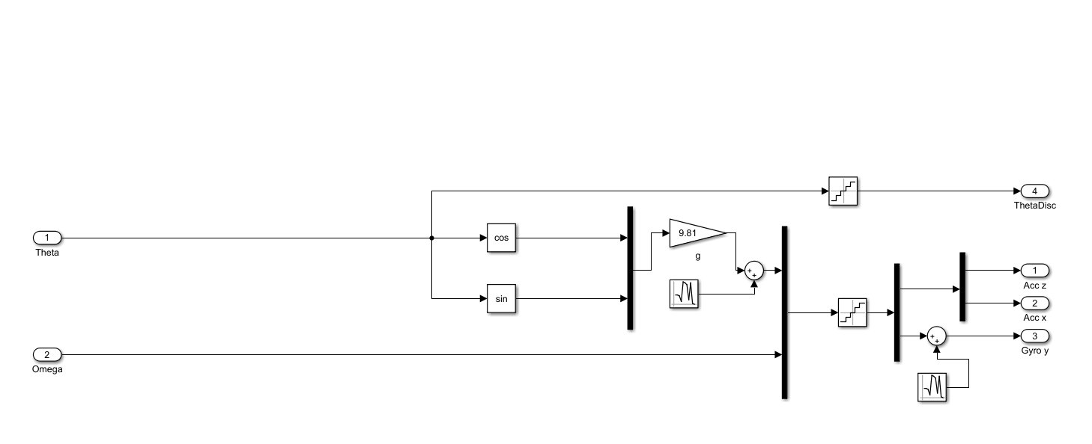
Simulink: Sensors
POLITECNICO DI MILANO

Slide 38
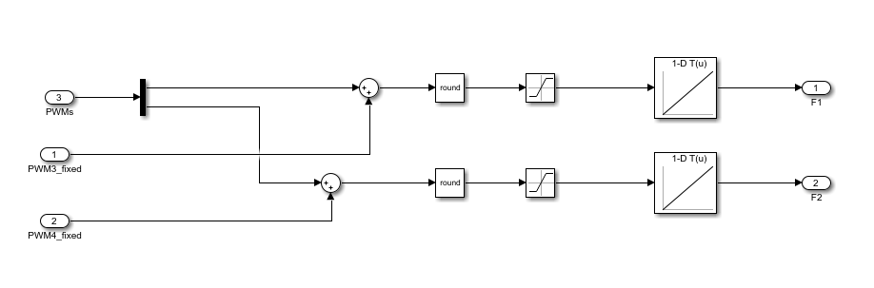
Simulink: Motors
POLITECNICO DI MILANO

Slide 39
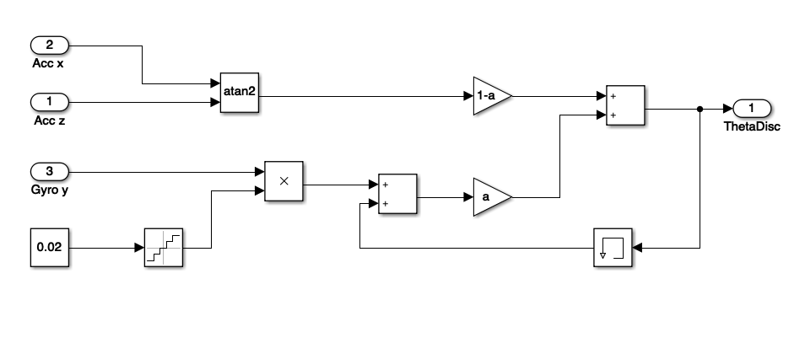
Simulink: Complementary Filter
POLITECNICO DI MILANO

Slide 40
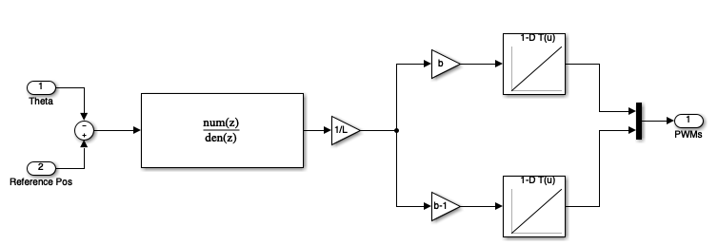
Simulink: PID
POLITECNICO DI MILANO

Slide 41
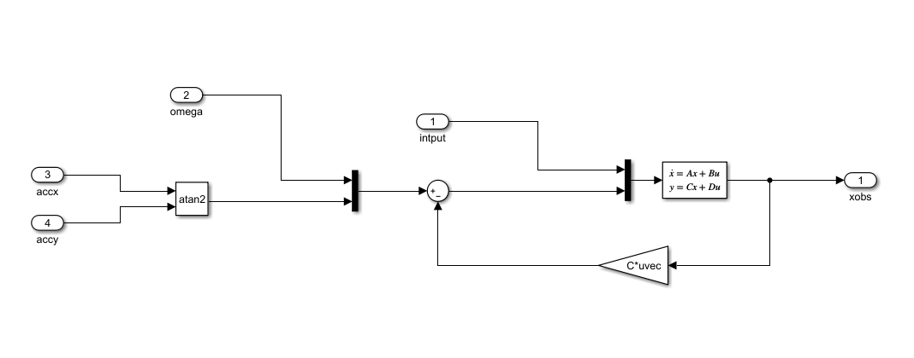
Simulink: Kalman Filter
POLITECNICO DI MILANO

Slide 42
Simulink: LQR
POLITECNICO DI MILANO

